Slide 1
Prudential Dataset
Anqi Ren
Akshaya Suresh
Krutika Deshpande
Ronak Mistry

Slide 2
APPROACH
OBJECTIVE
To analyze the Prudential Life Insurance dataset and predict the data points in the existing evaluation and sanction the outcomes to significantly amalgamate the process by building the Linear Regression, Decision Tree Regression, SVM Regression and XGBoost linear booster models to conclude the results.
Built a predictive model for Prudential Life Insurance by evaluating the risk factor associated with various parameters in an application to accurately classify risk on a scale of 1-8 (8 being the highest) using a more automated approach.

Slide 3
DATA PREPARATION
The data contains 128 variables. 110 are categorical variables, 13 continuous variables and 5 discrete variables
Categorical variables contain a finite number of categories. The highest being 579 for ‘Medical_History_2’. This field could be classified as a discrete variable, however, since the Kaggle description explicitly mentions it as categorical, we have left it as is.
Discrete variables are numeric variables that have a countable number of values between two values. Such as (Medical_History_10)
Continuous variables are numeric variables that have an infinite number of values. These are all classified as float values. For example, (BMI)

Slide 4

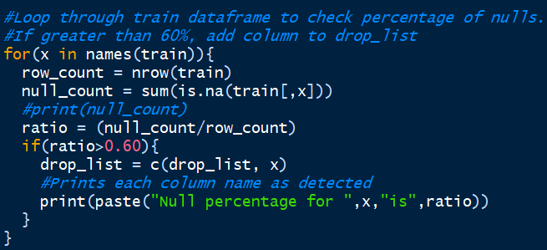
Data Preparation
The first step we took after importing the dataset, is to analyze the data for nulls.
We then ran a function to identify all columns with nulls greater than 60%.

Slide 5
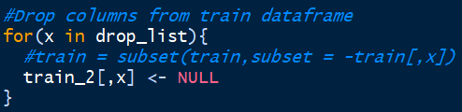
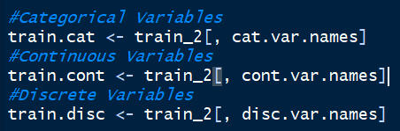
Data Preparation Continued
The columns with nulls >60% are identified and then dropped since they will not be effective to be used in making any predictions.
We then exclude the response variable and split the dataframe into 3 based on the types of variables; i.e. Categorical, Continuous, Discrete
These splits are made based on the variable descriptions provided on Kaggle.

Slide 6
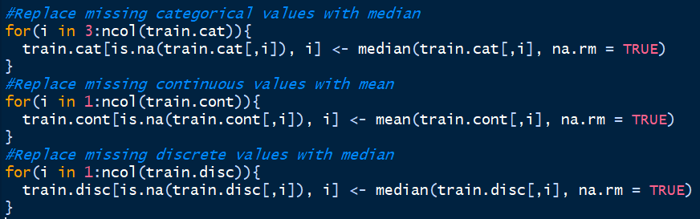
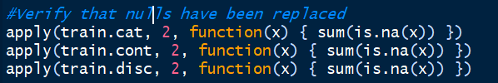
To deal with any null values, we replace all integer values with the median for the respective column, and, all numeric values with the mean for the respective column
We then run a function to verify that all nulls have been replaced.

Slide 7

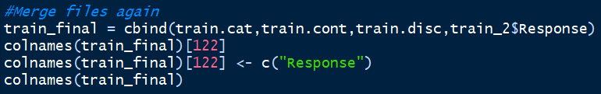
Data Transformation
In order to feed categorical variables to our models. We need to convert them to their numeric representation
We make use of factor to accomplish this task
This step completes the data preprocessing and we merge the 3 dataframes back into one along with the Response variable

Slide 8

Train – Test Split
The dataset on Kaggle provides us with 2 separate files for train and test. However, the test dataset lacks the response variable.
While we could still train a model using these datasets, we would be unable to evaluate the models due to the missing response variable.
To work around this problem, we have used only the train dataset provided and have split it using an 80:20 ratio.

Slide 9
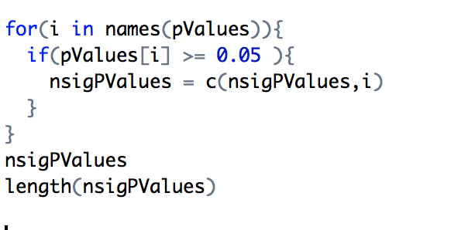
Linear Regression Model
Determines the extent to which there is a linear relationship between a dependent variable and one or more independent variables
First step,
We need to find a suitable regression model by selecting only the attributes with a significant p-values. Other attributes must be eliminated

Slide 10
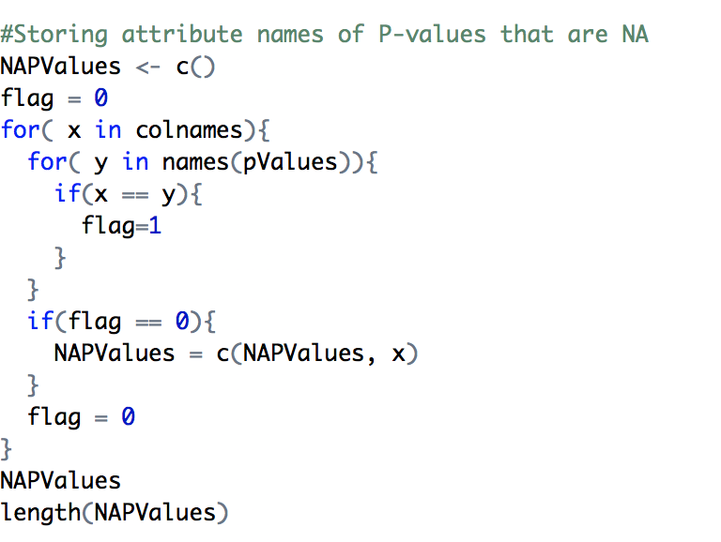
Linear Regression
We do that by,

Slide 11
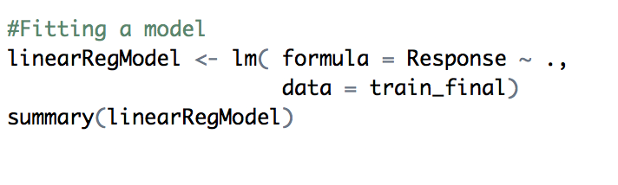
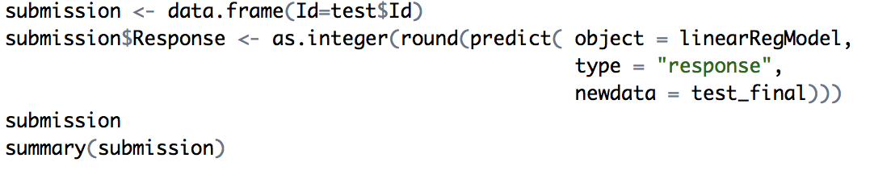
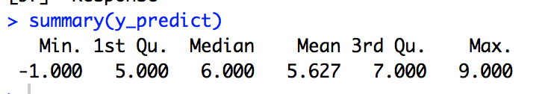
Linear Model
The number of attributes are reduced to 96 and now with these variables apply the model
Use the model to predict the response variable in the test data
RMSE = 1.99

Slide 12
Decision Tree Regression
Decision tree builds regression or classification models in the form of a tree structure. It brakes down a dataset into smaller and smaller subsets while at the same time an associated decision tree is incrementally developed. The final result is a tree with decision nodes and leaf nodes.
Regression tree analysis is when the predicted outcome can be considered a real number
Core algorithm is CART (Classification And Regression Tree)
Use “rpart” to create the model

Slide 13
rpart Parameters
formula: a formula, with a response but no interaction terms. If this is a data frame, that is taken as the model frame
Data: an optional data frame in which to interpret the variables named in the formula.
na.action: the default action deletes all observations for which y is missing, but keeps those in which one or more predictors are missing.
method: “anova”, “class”, “poisson”, “exp”
parms: optional parameters for the splitting function. Anova splitting has no parameters.
control: a list of options that control details of the rpart algorithm.
minsplit
cp

Slide 14

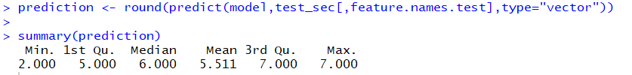
Decision Tree Model
The model is trained as follows
Prediction Results

Slide 15
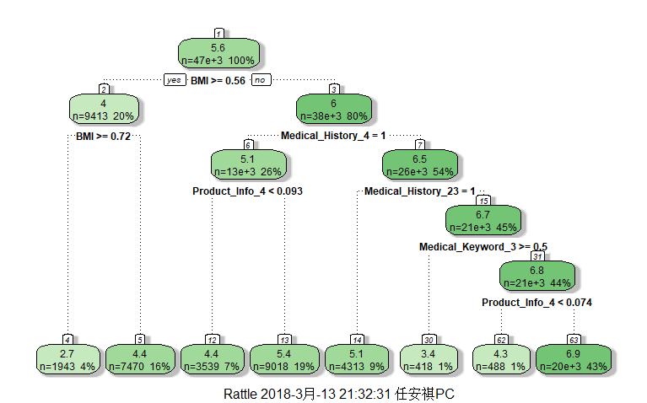
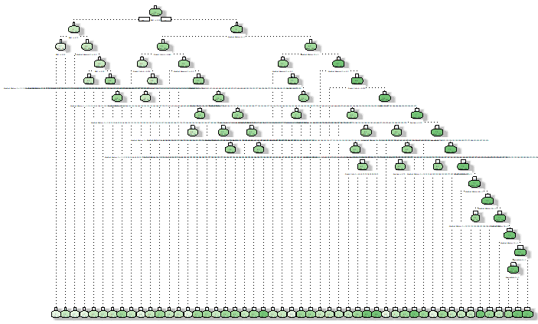
Results and Evaluations
When parameter cp=0.01 When parameter cp=0.001
RMSE: 2.14 RMSE:2.07

Slide 16
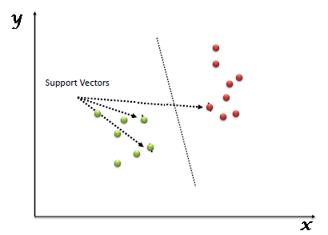
Support Vector Machine (SVM)
SVM – supervised machine learning algorithm
Classification Regression
Classifies the data by finding hyperplane that differentiate the two classes very well
The effectiveness of SVM is attributed to its ability to transform a 2D data plane into a higher dimensional featured space, which is achieved using kernels
For delivering a good prediction model tuning a SVM function for gamma and cost values is critical
Using selected features and the best parameters, run the SVM algorithm to predict the response
Predicted values are then compared and RMSE is calculated to ascertain errors in the prediction

Slide 17
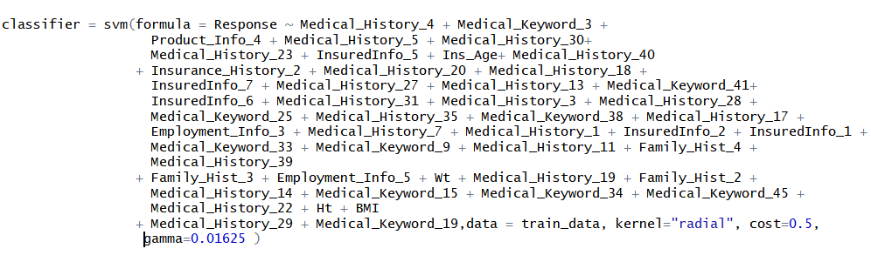
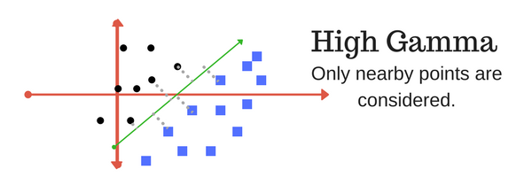
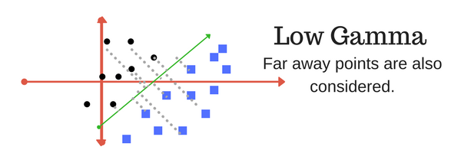
SVM Model and Parameters

Slide 18
Support Vector Machine (SVM)
We tried all the kernels with the selected Gamma and cost values and found the radial kernel to be the most effective.
The RMSE value of 2.15 was obtained.
rmse = sqrt((sum(y_pred-test_data$Response)^2)/length(y_pred))
print(rmse)
2.156644

Slide 19
XGBoost
For XGBoost, we must set three types of parameters: general parameters, booster parameters and task parameters.
General parameters relates to which booster we are using to do boosting, in our case it is a linear model
Booster parameters depends on which booster you have chosen.
Learning Task parameters that decides on the learning scenario, for instance, regression tasks uses different parameters with ranking tasks.

Slide 20
XGBoost Parameters
max_depth: This is the maximum depth of the tree. If this value is too high it may cause overfitting and increase model complexity.
eta: This is the learning rate. This parameter is used to counter overfitting and makes the model more conservative. A decrease of this parameter, implies an increase to the nrounds parameter.
min_child_weight: This is the minimum weight needed for a leaf node for further partitioning to take place.
subsample: This is the ratio of data that XGBoost will collect to grow trees. This parameter also helps prevent overfitting.
eval_metric: This is the metric used to evaluate the model. We have set it to ‘rmse’
nrounds: This is the number of rounds/iterations of the data for boosting.

Slide 21
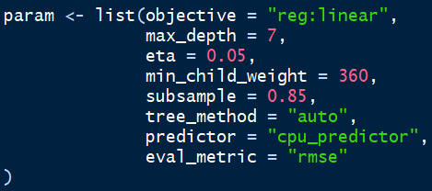
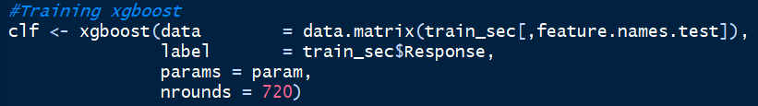
XGBoost Model
We train an XGBoost using the following parameters
The model is trained as follows

Slide 22
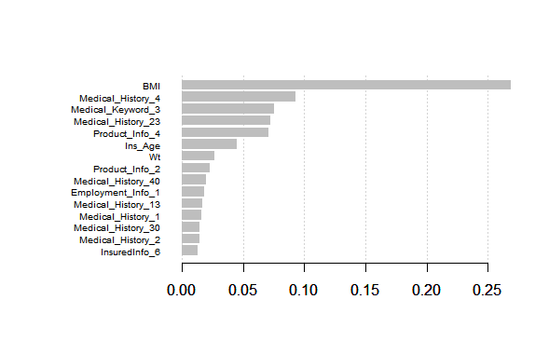
XGBoost Evaluation
We use the ‘rmse’ value to evaluate the model we built.
RMSE: 1.91
The following plot displays the top 15 features in the XGBoost model.

Slide 23
Conclusion
A general comparison of RMSE values for all four algorithms is shown below.
Linear Regression: 1.99
Decision Tree: 2.14
SVM: 2.15
XGBoost: 1.91
Based on the above findings, we can conclude that XGBoost is a better algorithm for tackling the Prudential dataset with Linear Regression coming in a close second.

